Slide 1

CUSTOMER SEGMENTATION

Slide 2
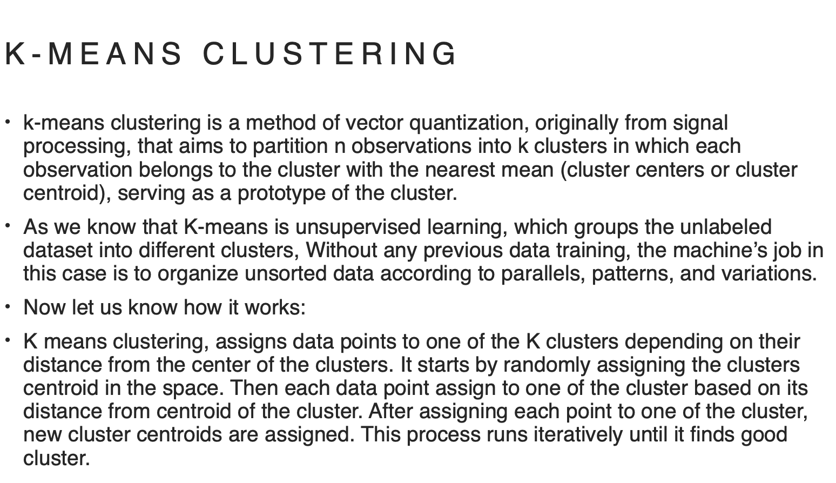

Slide 3
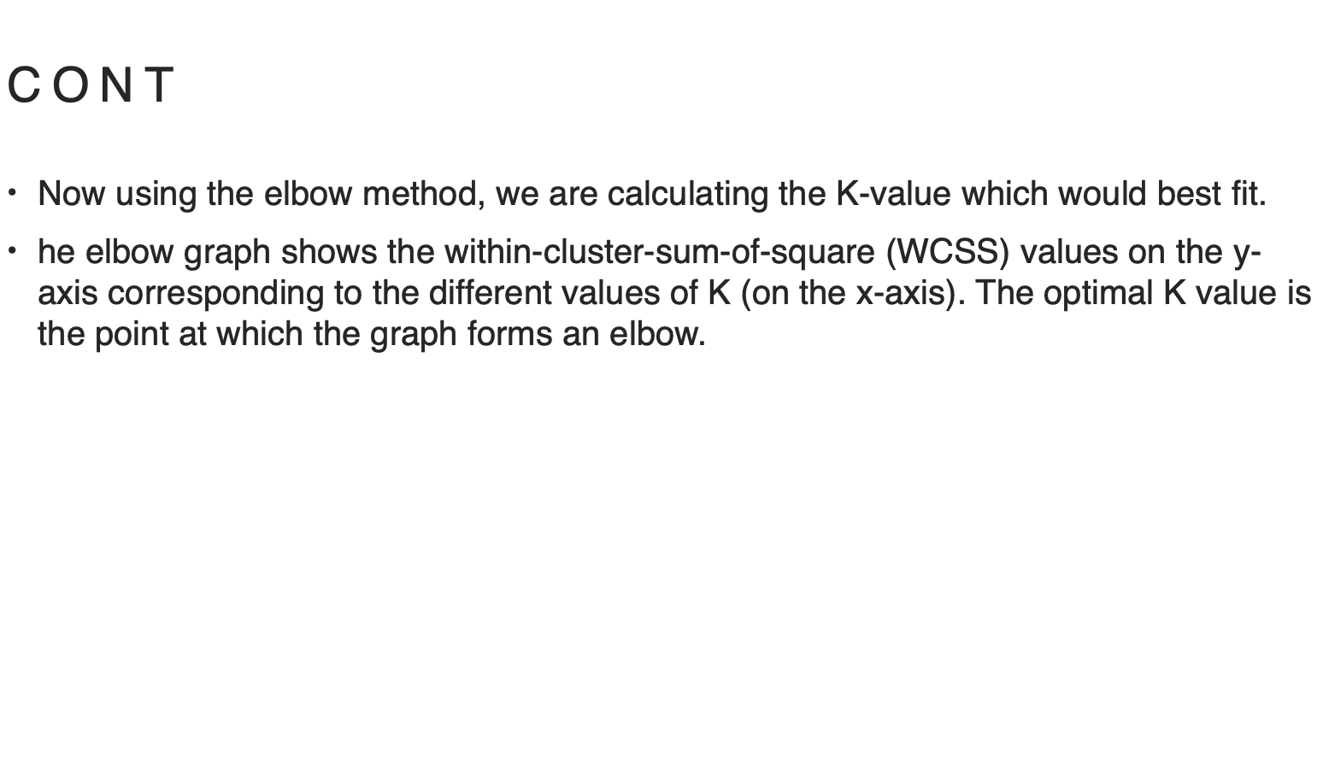

Slide 4
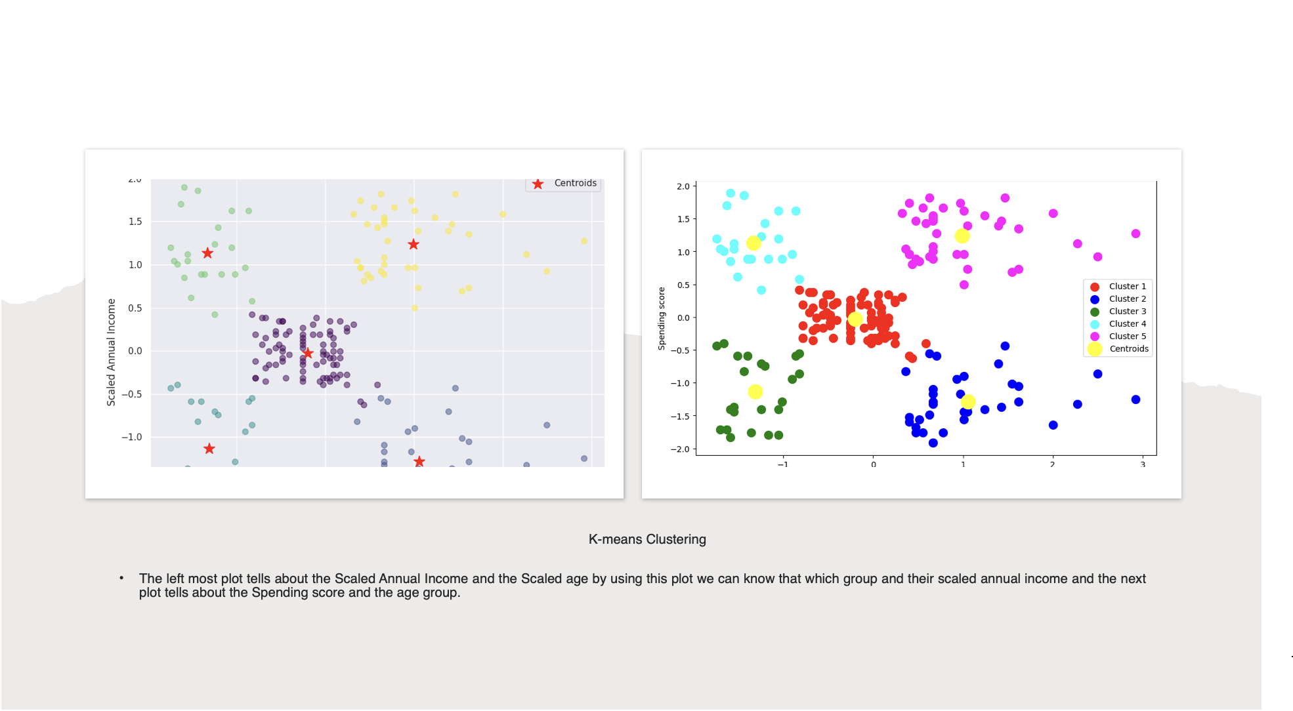

Slide 5
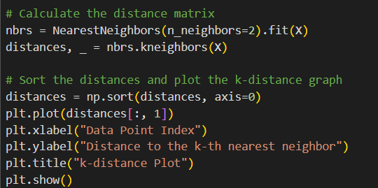
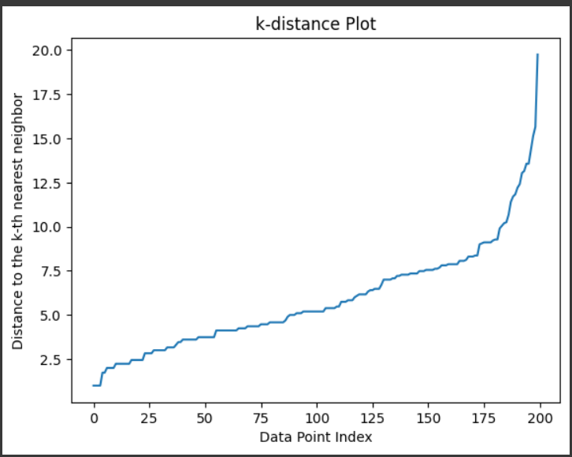
Density Based Spatial Clustering of Applications with Noise
(DBSCAN)
DBSCAN groups together points that are closely packed together, ignoring areas with low density.
It starts by picking a random point and finds all its neighboring points within a specified distance “EPSILON”.
If the number of neighbors exceeds a certain threshold “Minpts or Min_sample”, it forms a cluster with those points.
To get the Idea about how data points are distributed we calculate distance matrix and Plotted .

Slide 6
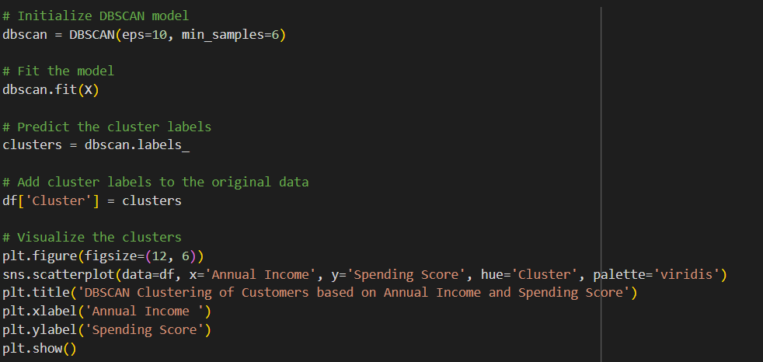
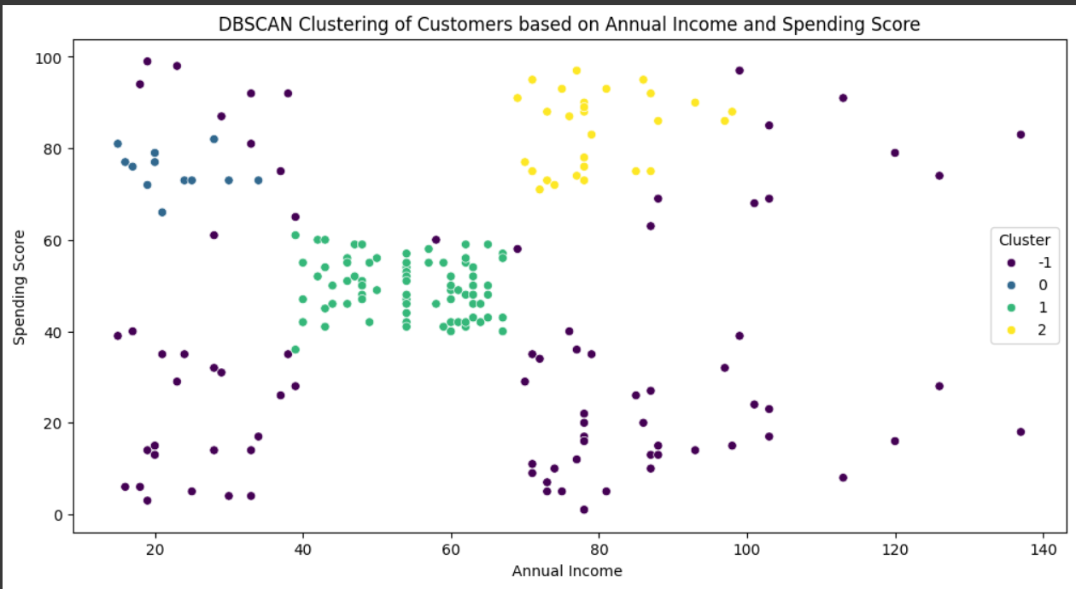
From the Data set provided for customer segmentation I consider “Age” for Clustering those data points in Scale of Annual Income, Spending Score .
From the K-distance graph that is plotted to get the idea how data points distributed, and most data points have neighbors from 5-10 we call it “Kth nearest neighbor”.
Testing the values from 5-10 as eplison values in code (i.e eps=10 )
Testing the values from 3-6 as min_sample value in code (min_samples=6)
After the Clusters are created and visualized the clusters are shown like (-1(Outliner or Noise),0,(belongs to none), 1,2(Clusters))

Slide 7
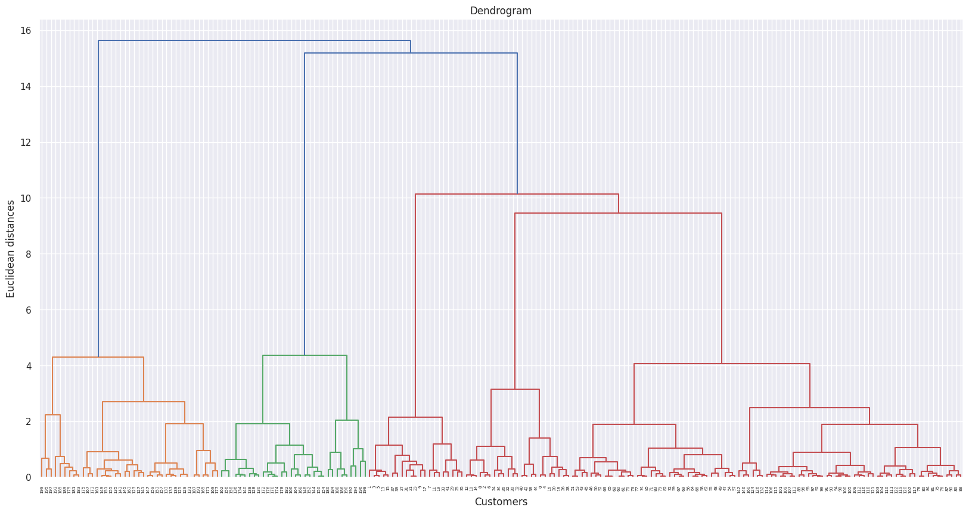
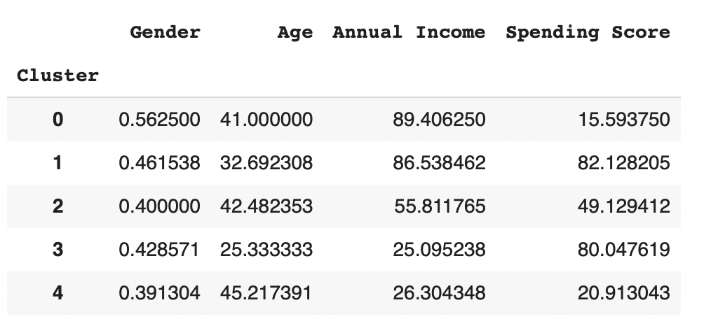
Hierarchical Clustering
Organizes data into a dendrogram-based tree structure and interprets the clustering patterns without the need for predefining the number of clusters.
Agglomerative Clustering: Each data point starts as its own cluster, and at each step two closest clusters are merged together based on a distance metric.
Linkage: Single, Complete, Ward, Average
Metrics: Euclidean, Cosine, Manhattan

Slide 8
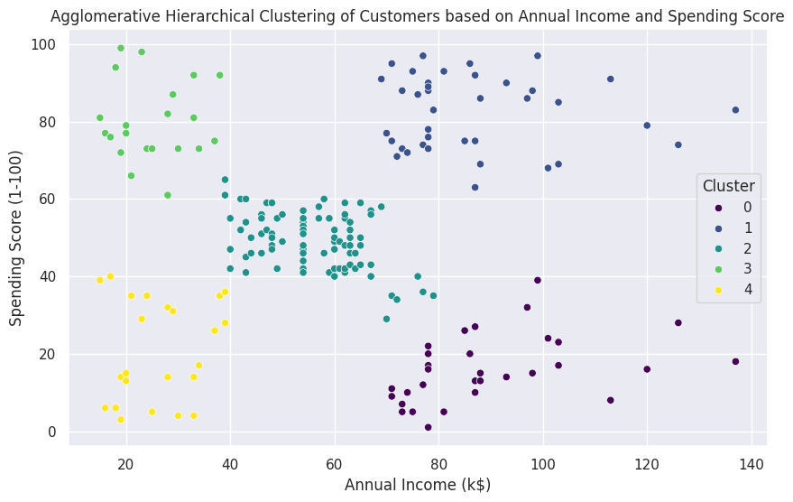
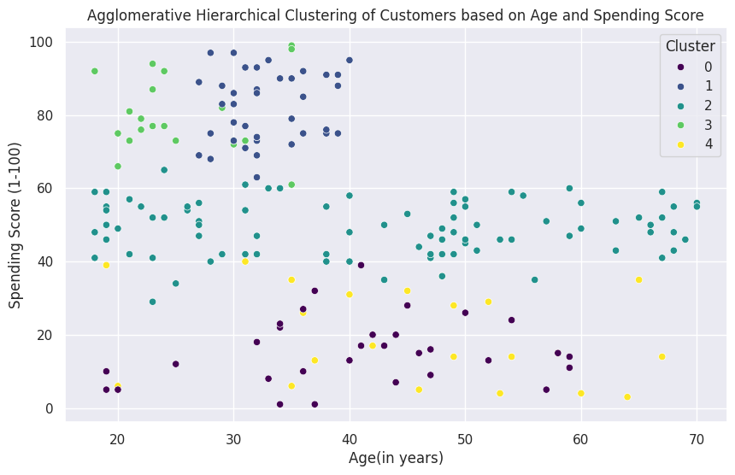
Assigns customers to clusters based on their annual income and spending score, revealing distinct patterns in their behavior across different demographic dimensions.
Assigns customers to clusters based on their Age and spending score, revealing distinct patterns in their behavior across different demographic dimensions.

Slide 9
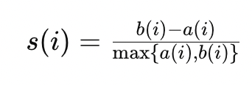
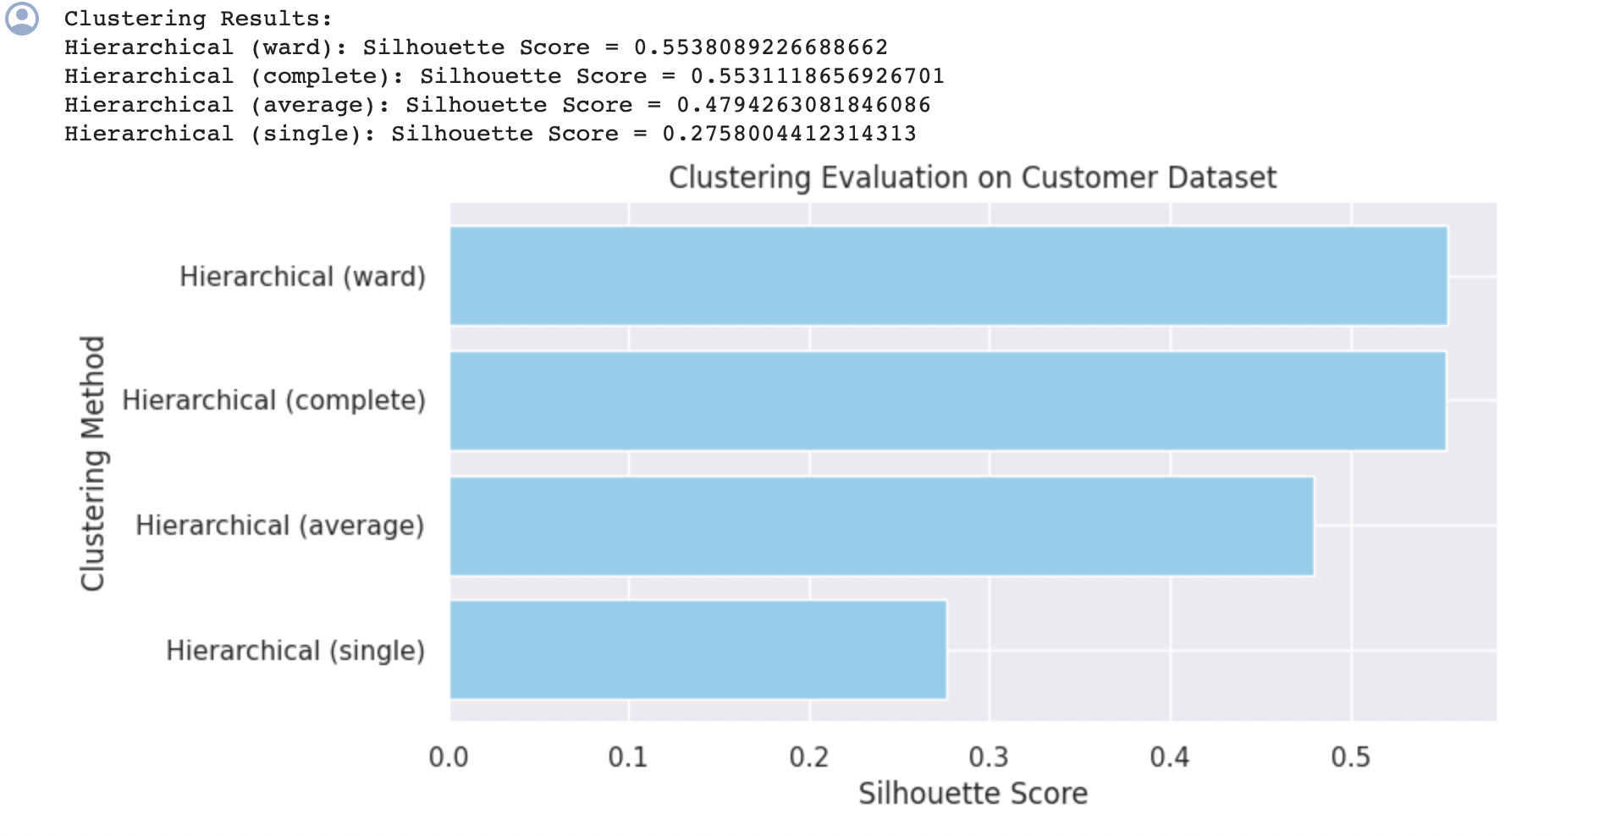
Silhouette score
Evaluate the quality of clusters created by a clustering algorithm.
Ranges from -1 to +1
where b(i) is inter-cluster distance, a(i) is intra-cluster distance
+1: well clustered and far away from neighbour clusters
0: close to decision boundary
-1: probably in the wrong cluster

Slide 10
Thank you

